Slide 1

SRM INSTITUTE OF SCIENCE AND TECHNOLOGY
SCHOOL OF COMPUTING
DEPARTMENT OF COMPUTING TECHNOLOGIES
18CSP109L- MAJOR PROJECT
Real-Time Object Detection and Distance Mapping
TEAM : BATCH ID - 1
Student 1: KINTHALI SAKETH (RA2111003011009)
Student 2: PUDI SAI KRISHANA (RA2111003011033)
Project Guide Name: Dr. V. Raghavendra
Designation: Assistant Professor
Department: Computing Technologies

Slide 2
Table of Contents
Objective of the work
Daily Scrum
Architecture
Module Description
Functional Test Case
Result analysis
References

Slide 3
Objective of the work
Develop an Object Detection System using YOLOv8 to identify objects in images and videos.
Implement Real-Time Object Detection using a webcam feed for dynamic analysis.
Integrate Distance Measurement to estimate object proximity and enhance safety applications.
Utilize Pre-trained YOLO Models (yolov8n.pt, yolov8m.pt) for accurate and efficient detection.
Process Video Streams to detect and track objects frame-by-frame.
Use Speech Output (pyttsx3) to provide audible feedback on detected objects.
Analyze COCO Dataset Categories for object classification and detection optimization.
Improve Accuracy with Convolutional Techniques (conv.py) for better feature extraction.
Optimize Detection Performance by adjusting frame rate, distance calculations, and pixel-to-meter conversion.
Develop a Scalable System that can be extended for applications like autonomous vehicles, surveillance, and smart assistance.

Slide 4
Daily Scrum
Week 1-2: Research on YOLOv8 and dataset selection.
Week 2-3: Implementation of object detection on static images.
Week 3-5:Integration of real-time detection with webcam input.
Week 5-7:Development of distance estimation functionality.
Week 7-8: Adding voice feedback using text-to-speech.
Week 8-10:Finalizing documentation and result analysis.

Slide 5
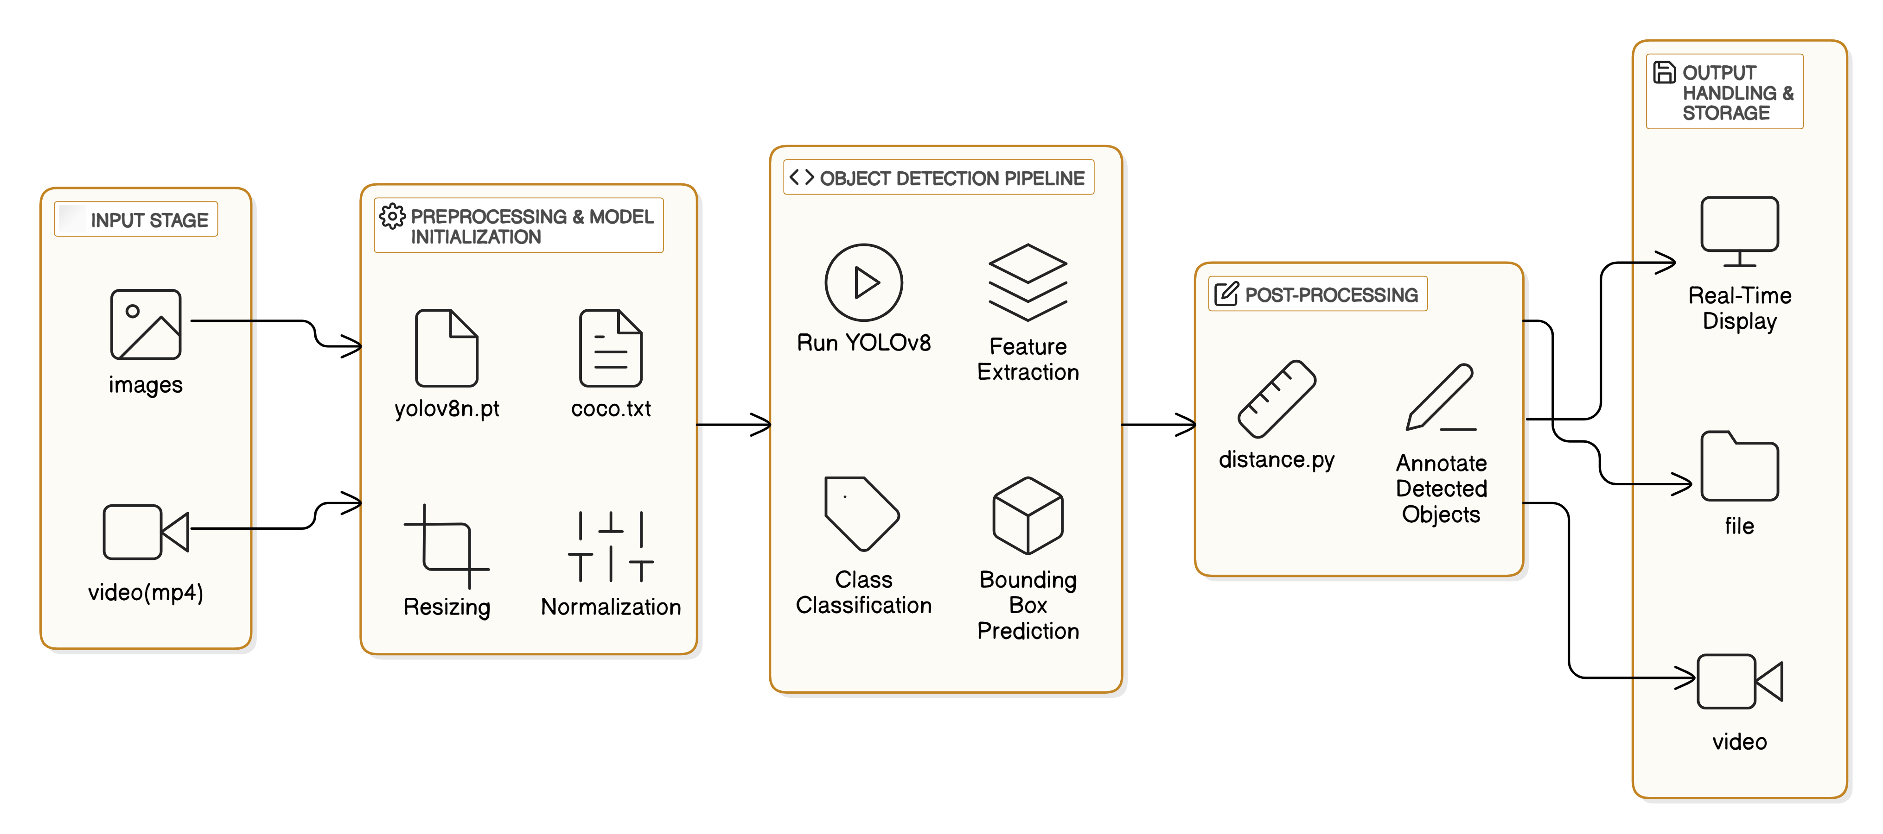
Architecture

Slide 6
Module Description
conv.py - Implements convolutional layers and enhancements for deep learning models.
object detection.py - Performs object detection on static images using YOLOv8.
real time.py - Implements real-time object detection with voice alerts and distance measurement.
test4.py - Detects and tracks objects in a video with YOLOv8.
video with distance.py - Processes video files, detects objects, and calculates distances.

Slide 7
Test Case
Test Case 1: Verify that the YOLOv8 model loads successfully.
Expected Output: The model is initialized without errors and ready for object detection.
Test Case 2: Detect objects in a given image.
Expected Output: The model correctly identifies and labels objects present in the image.
Test Case 3: Perform real-time object detection using a webcam.
Expected Output: The system detects and labels objects dynamically in the live video feed.
Test Case 4: Measure the distance of detected objects.
Expected Output: The system accurately calculates and displays the distance between the camera and detected objects.
Test Case 5: Provide voice feedback for detected objects.
Expected Output: The system audibly announces detected objects using text-to-speech conversion.

Slide 8
Result Analysis
The object detection system successfully detects objects in real-time and from static images.
Distance measurement works well for known object sizes and focal length.
The voice feedback system announces detected objects correctly.
Overall, the system performs efficiently, with an acceptable detection speed

Slide 9
References
Fan, Xiangyu. "YOLOv8-Lite: A Lightweight Object Detection Model for Real-time Autonomous Driving Systems." IECE Transactions on Emerging Topics in Artificial Intelligence 1, no. 1 (2024): 1-16.
Huang, Huadong, Binyu Wang, Jiannan Xiao, and Tianyu Zhu. "Improved small-object detection using YOLOv8: A comparative study." Applied and Computational Engineering 41 (2024): 80-88.
Verma, Urvashi, Anshul Kalia, and Sumesh Sood. "YOLOV8: An Enhanced Object Detection Model for Distance Estimation." International Journal of Intelligent Systems and Applications in Engineering 12, no. 21s (2024): 3852.
Silva, Diego A., Kamilya Smagulova, Ahmed Elsheikh, Mohammed E. Fouda, and Ahmed M. Eltawil. "A Recurrent YOLOv8-based framework for Event-Based Object Detection." arXiv preprint arXiv:2408.05321 (2024).
Wang, Gang, et al. "UAV-YOLOv8: A Small-Object-Detection Model Based on Improved YOLOv8 for UAV Aerial Photography Scenarios." Sensors 23.16 (2023): 7190. ​
Wang, X. "BL-YOLOv8: An Improved Road Defect Detection Model Based on YOLOv8." Sensors 23.20 (2023): 8361. ​

Slide 10
THANK YOU

